Slide 1



The APPROACH Trial:
Assessing Pain, Patient Reported Outcomes and Complementary & Integrative Health
12th Annual Conference on Statistical Issues in Clinical Trials
Center for Clinical Epidemiology and Biostatistics – U Penn
April 17, 2019
Steve Zeliadt, PhD
University of Washington
VA Center of Innovation for Veteran-Centered & Value-Driven Care
Seattle, WA

Slide 2
Acknowledgements
Stephanie Taylor, PhD
  Co-Principal Investigator/Los Angeles VA/UCLA
Scott Coggeshall, PhD
  Biostatistician/VA Puget Sound/University of Washington

Slide 3

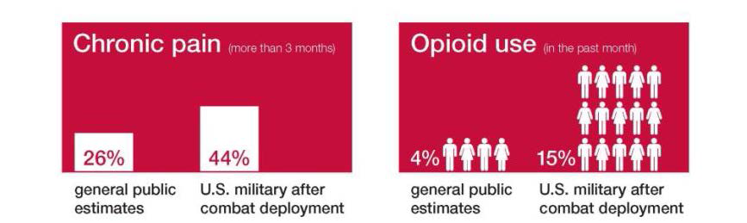
Mechanism: NIH-DOD-VA Pain Management Collaboratory
www.painmanagementcollaboratory.org
APPROACH - 1 of 11 Pragmatic Trials – UG3/UH3 mechanism
Military & VA Healthcare systems
Recognition that non-pharmacological approaches are needed

Slide 4
Requested Pragmatic Components
“The overall goal of this initiative, jointly supported by the NIH, DoD, and VA, is to develop the capacity to implement cost-effective large-scale clinical research in military and veteran health care delivery organizations focusing on non-pharmacological approaches to pain management and other comorbid conditions”
“intervention(s) should be able to be reliably delivered by clinical providers and/or health care systems”
“the pragmatic trial should allow for interventions to be implemented with maximal flexibility and by all appropriate practitioners (not just those with exceptional levels of training or competence whenever possible)”
“utilize electronic health records to leverage data collection that occurs in health care delivery rather than requiring independent research data collection”

Slide 5
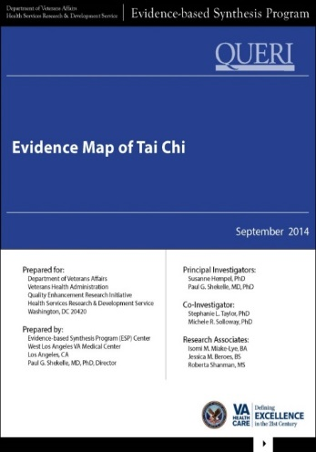
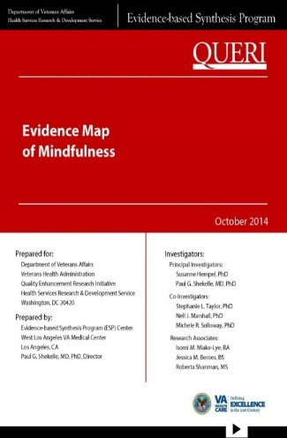

Background – CIH & Pain
2018-2024 VA Strategic Plan
“VA will also reinforce preventive health care practices to include incorporating complementary and integrative health care practices to reduce addiction, manage chronic pain, and improve mental health and other conditions that respond well to these interventions.”

Slide 6
Evidence Maps - Acupuncture

Slide 7
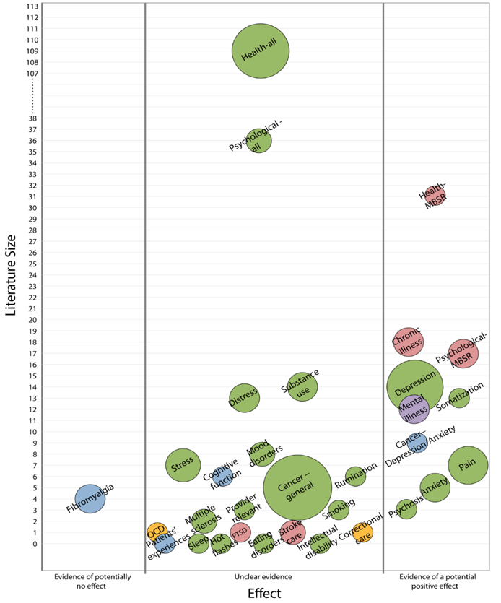
Evidence Maps - Mindfulness

Slide 8
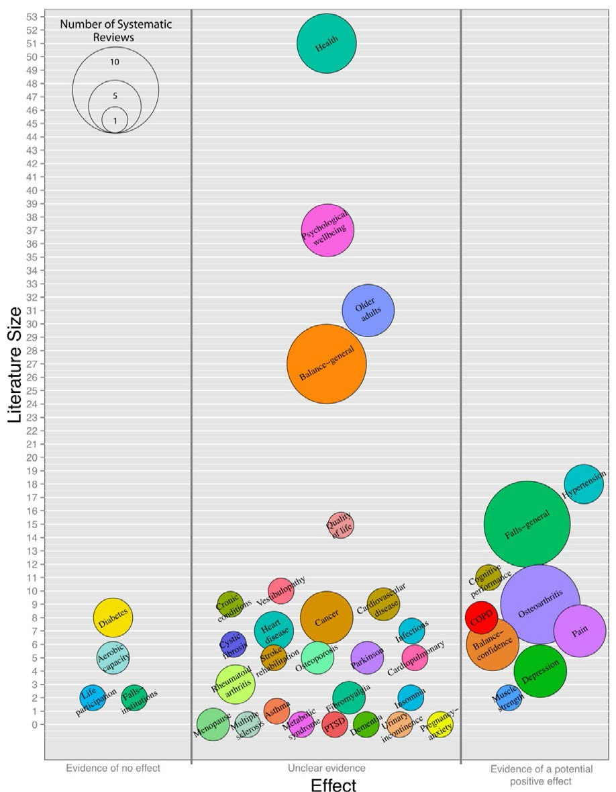
Evidence Maps – Tai Chi

Slide 9
Health System & CIH
“Who you see is what you get” – Dan Cherkin; Kaiser Permanente/Group Health Cooperative
United Healthcare
  Medical provider: $2800
  Non-traditional provider (usually chiropractor): $700

Slide 10


2016 Comprehensive Addiction
& Recovery Act (CARA)
Key goal to increase CIH utilization
  5 main types: yoga, Tai Chi, mindfulness, acupuncture & chiropractic
  18 Flagship sites receiving $5+ million each to hire CIH and well being providers/coaches
  Financial incentives associated with Veterans receiving 10+ CIH visits (bump in a Medical Center’s capitated allocation)
  Network director performance plan (e.g. director pay incentives)
  Surveys with Veterans – 52% are using some CIH (44% inside VA)
                Taylor et al, JGIM, 2019

Slide 11
VA Leadership -> Health System Hypothesis
What is the role of CIH within Health Systems?
Not looking for evidence about which single CIH modality performs best
VA Leadership does not support randomizing to specific types of CIH – interferes with Veteran choice
“A critical question for the field is whether adding self-care strategies to practitioner-delivered CIH increases effectiveness of pain management”
Three arm trial:
  Practitioner-delivered only (acupuncture/chiropractic)
  Self-care only (yoga, Tai Chi, mindfulness)
  Dual care

Slide 12
CIH Patterns (FY 18)
Site | Individuals with CIH use | Dual | Practitioner Only | Self-care Only
Boston | 652 | 1% | 74% | 25%
Tampa | 2858 | ? | 99% | 1%
Atlanta | 872 | 3% | 37% | 60%
Saginaw | 628 | 6% | 80% | 14%
St. Louis | 2298 | 1% | 99% | ?
East Orange | 883 | 6% | 75% | 19%
Tucson | 1759 | 5% | 67% | 28%
SLC | 942 | 11% | 38% | 51%
Overall | 10,892 | 3% | 79% | 18%

Slide 13

Alternatives to Treatment Randomization
Endogeneity problem without randomization
  Treatment may be correlated with error
Instrumental variable/two-stage predictor substitution
  IV influences treatment choice
  IV is unrelated to outcome (except through treatment)
    e.g. Exogenous shift in treatment
IV allows estimation of Local Average Treatment Effect
  “the treatment effect among those marginal individuals whose treatment statuses would likely change with a change in the instrument” (Imbens & Angrist 1994)

Slide 14
CIH & Dual CIH Incentives/Nudges
Many initiatives being tested in the field:
  Pre-acupuncture class – includes exposure to Tai Chi
  “Pain academy” that emphasizes multiple CIH modalities
  Chiropractor strongly advocates for yoga/provides introduction
  Develop an initial pain treatment plan that includes multiple CIH modalities
  Passport stamp book where Veteran receives massage for attending 10 CIH activities
  Incentivize acupuncture participation (scheduling priority/avoiding wait times for acupuncture) if participate in yoga/Tai Chi

Slide 15
Randomizing/Structuring Nudges
Interest in testing effectiveness of nudges
Business case for clinics not to offer nudges haphazardly
  Pragmatic structuring of nudges when randomization isn’t possible (e.g. offer only through specific clinics, only on Fridays)
Receipt of nudge = 0/1 Instrumental Variable
LATE: Focus on marginal patient induced to use dual care by nudges who wouldn’t otherwise have used dual care
Site | Individuals with CIH use | Dual | Practitioner Only | Self-care Only
Overall | 10,892 | 3% | 79% | 18%

Slide 16

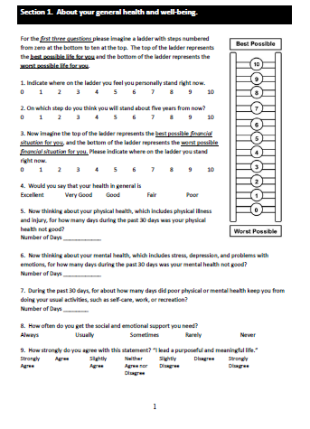
Pragmatic Considerations
VA has distinction between QI/Operations and Research
  QI/Operations goal must be internal QI, not generalizable knowledge; Input by researchers to increase evaluation rigor
  Operations collecting patient reported outcomes among CIH users
    Originally planned 1000 per site (n=18,000); testing electronic methods
  EHR data available (e.g. pain rating, opioid rx)
Consent/determination of “research participant”
  Allocation to receipt of nudges by field
  Cannot be “determined/manipulated by researchers”

Slide 17
Statistical Concerns
Weak instruments
Residual confounding
Endogeneity (nudges may influence outcomes through mechanisms other than dual CIH use)
Efficiency/sample size

Slide 18
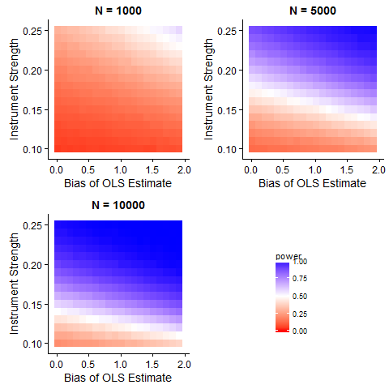
Sample size simulations
Exploring efficiency of two-stage IV predictor substitution
  Input: 10% baseline use of dual use CIH
  Input: 2 point true/LATE improvement in Brief Pain Inventory (e.g. bias 0.5 = 1.5 or 2.5)
  Input: 3 equally sized arms/2 comparisons

Slide 19
Simulation findings
2SLS inefficient when IV/bias is not present
  Estimate of strength/direction of bias is uncertain
Need nudges to be effective at increasing dual use
  80% power requires >2.5-fold increase in dual CIH use (e.g. 10% to >25%)

Slide 20
Summary
Ongoing randomization/manipulation of IV nudge is novel application
  Feasibility of unbiased inference
  Inefficient (but research costs offset by pragmatic data collection)
Health system hypothesis requires coordination with care settings
  Intervention as delivered by system: Dual CIH
  Requires creative blend of research/operations
LATE and generalizability – do those patients who can be influenced by nudges reflect full patient population?
APPROACH trial depends on continued emphasis/expansion of CIH (but not too fast)

Slide 21
A Couple of Key References
Imbens G, & Angrist J. Identification and estimation of local average treatment effects. Econometrica, 1994; 62(2), 467–475.
Basu A, Coe NB, Chapman CG. 2SLS versus 2SRI: Appropriate methods for rare outcomes and/or rare exposures. Health Economics, 2018; 27(6)937-955.
  “2SLS are consistent estimators of LATE over a wide range of scenarios”

Slide 22
Thank you!

