Slide 1
IMPACT-AFib: An 80,000 Person Randomized Trial Using the
FDA Sentinel System Platform
Richard Platt, MD, MSc
Harvard Medical School and Harvard Pilgrim Health Care
April 17, 2019

Slide 2
Atrial fibrillation, a common and important problem
Over 5 million people in the United States have AFib
  2% of people younger than age 65
  9% of people aged >65 years
5 fold increase in risk of stroke
  15-20% of ischemic strokes are due to AFib
Contributes to 130,000 deaths
$6 billion added annual cost ($8,700 per person with AFib)
www.cdc.gov/dhdsp/data_statistics/fact_sheets/fs_atrial_fibrillation.htm

Slide 3
Rationale for IMPACT-AFib trial
Oral anti-coagulant underuse is a public health priority
Also a priority of health plans
Mailed interventions are consistent with routine health plan interventions
Eligible population are identifiable and major outcomes measurable using Sentinel Distributed Database

Slide 4
FDA-Catalyst: IMPACT-AFib randomized trial
IMplementation of a randomized controlled trial to imProve treatment with oral AntiCoagulanTs in patients with Atrial Fibrillation
Direct mailer to health plan members with AFib, high risk for stroke and no oral anticoagulant treatment, and to their providers, to encourage consideration of OACs

Slide 5
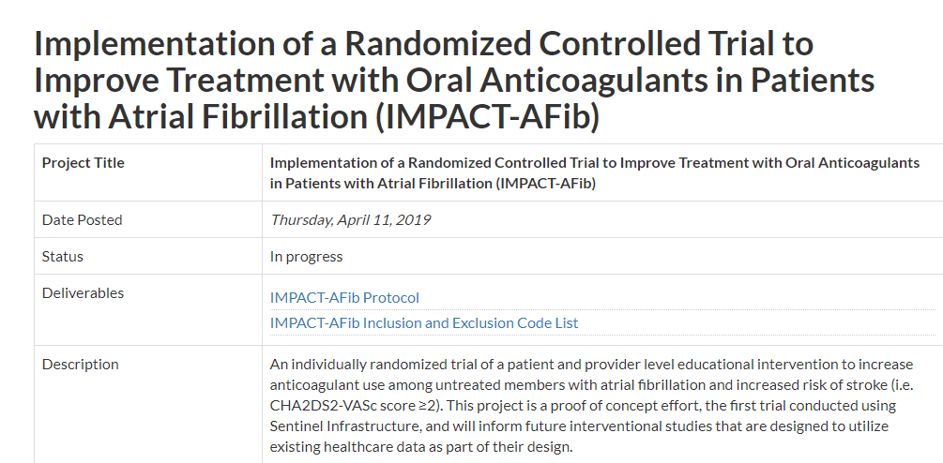
www.sentinelinitiative.org/FDA-catalyst/projects/
implementation-randomized-controlled-trial-improve-treatment-oral-anticoagulants-patients
ClinicalTrials.gov NCT03259373

Slide 6




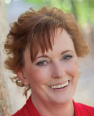


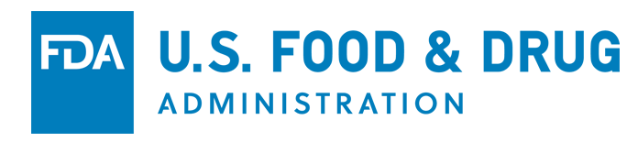



IMPACT-Afib Workgroup
Patient representative

Slide 7
Trial cohort eligibility
Adult ≥30 years old
  Medical & pharmacy coverage for ≥365 days
≥2 AFib diagnosis codes
No oral anti-coagulant dispensing (or ≥4 INR measurements) within the last year
High risk for stroke (CHA₂DS₂-VASc score >2)
Exclusions:
  History of mechanical prosthetic valve, deep vein thrombosis, pulmonary embolism, intracranial bleed
  Hospitalized bleed in last 6 months
  Current pregnancy
  Current P2Y12 inhibitor treatment, e.g., clopidogrel

Slide 8
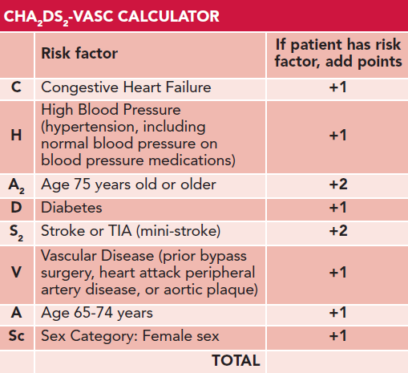
Notes:
CHADSVASc risk score calculate to calculate stroke risk for patients with atrial fibrillation, used by physicians to determine whether patient should be on anticoagulant.. Recommendation is that score >=2 are on OAC therapy

Slide 9
Look for oral anti-coagulant treatment, stroke/TIA,
bleeds (+365d)
AFib code 1 (index)
AFib code 2
12/2012
12/2013
12/2014
Example patient with AFib codes in red
No oral anti-coagulant treatment
(-365d)
Follow-up period: 365 days after 2013 diagnosis or until an event or disenrollment
Event definitions:
  Anticoagulant treatment (>1 NDC or >2 INR CPT codes)
  Stroke or TIA (>1 ICD-9-CM code in any care setting)
  Bleeding (>1 ICD-9-CM code in any care setting)

Slide 10
Preliminary results from five Data Partners
44,786 individuals identified with AF with
no evidence of current or recent oral anti-coagulant use
38,759 (87%) eligible for anticoagulant treatment
Among those, by end of follow up:
  12,867 (33%) had evidence of anticoagulant dispensing
  5,917 (15%) had a documented TIA or stroke
  3,469 (9%) had a documented bleeding event

Slide 11
Proportion of AFib members at five Data Partners with an event at end of follow up

Slide 12
Power for increasing anti-coagulant use
Primary Endpoint: > 1 oral anti-coagulant prescription fill through date on which at least 80% of study participants have >12 months of follow-up time
33% initiation rate in the delayed intervention arm over the first year of the study
38% initiation rate in the early intervention arm (a 5% absolute improvement)
1-year attrition rate: 30% dropout or lost-to-follow-up
Two-sided type I error of 0.05
10,000 patients yields more than 99% power to detect a 5% absolute difference

Slide 13
Power for decreasing stroke or TIA
Assume:
  80,000 patients, 80% followed for at least 12 months.
  1-year stroke or TIA rate:
    18% among patients not treated with anti-coagulant
    7% among patients treated with >1 anti-coagulant fill
  33% of delayed intervention patients have >1 fill of OAC →
  1 year stroke/TIA rate 14.4%
46% power if 38% of early intervention patients have >1 fill →
1 year stroke/TIA rate 13.82%, i.e., absolute decrease of 0.55%
80% power if 40.5% of early intervention patients have >1 fill →
1 year rate 13.54%, i.e., absolute decrease of 0.83%

Slide 14
Patients with AFib, CHADS-VASc ≥2
RANDOMIZE
Randomization
Usual Care and Delayed Provider intervention
Early Patient-level and Provider-level intervention
Access Pharmacy Records
Early Intervention
OAC in prior 12 months
No OAC in prior 12 months
12-months
Excluded
Intervention Mailed
Notes:
Criteria for waiver of consent:
The research involves no more than minimal risk to subjects;
The waiver or alteration will not adversely affect the rights and welfare of the subjects;
The research could not practicably be carried out without the waver of alteration
At 12 mo we access pharmacy records for delayed – and if still eligible and untreated, mail their providers letter
Assess primary and secondary outcomes at 12 mo (several months delay for claims to settle)

Slide 15
Mean CHADS-VASc
score of 5
Notes:
<50% female, Most >=75 yrs of age, mean CHADS score of 5
Age is on ETL end date

Slide 16
36% were not on treatment at time of randomization

Slide 17
Primary outcome: Proportion of AFib patients started on oral anti-coagulant the 12-month trial
Secondary outcomes:
Proportion of days covered with OAC prescription
Number of patients on OAC at end of one year
Admissions for stroke or TIA
Admissions for stroke
Admissions for bleeding
Deaths (subset)

Slide 18
Intervention Materials
PATIENTS
Letter from health plan
Patient brochure – information on AF and oral anti-coagulants
Patient pocket card – designed to facilitate conversation between patient and provider
PROVIDERS
Letter from health plan
Provider enclosure – myths and facts on OACs
Response mailer – providers to share feedback

Slide 19
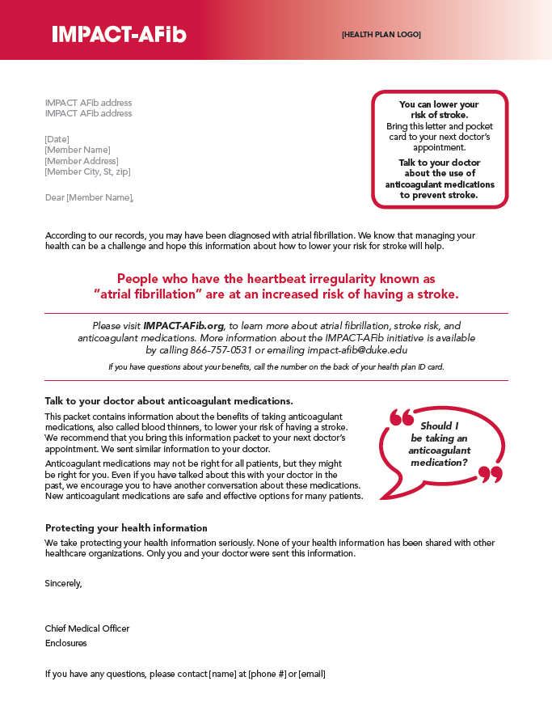
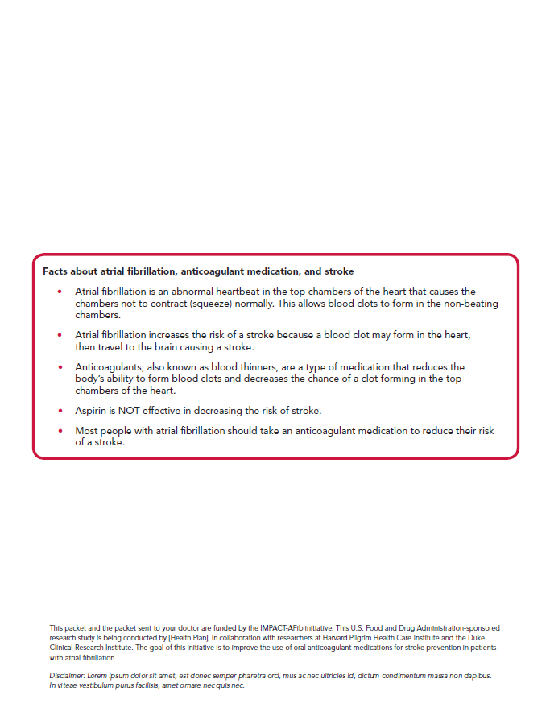

Slide 20
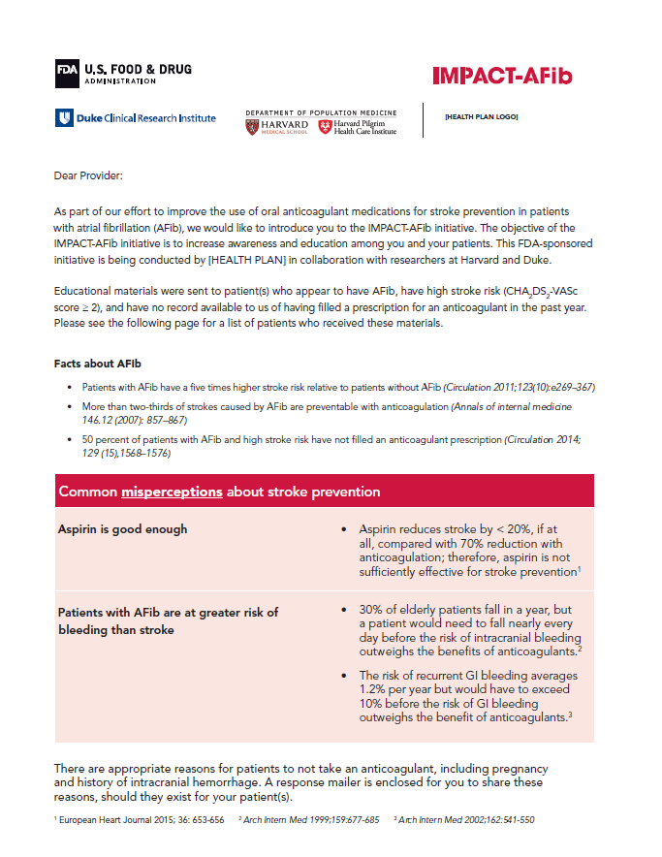
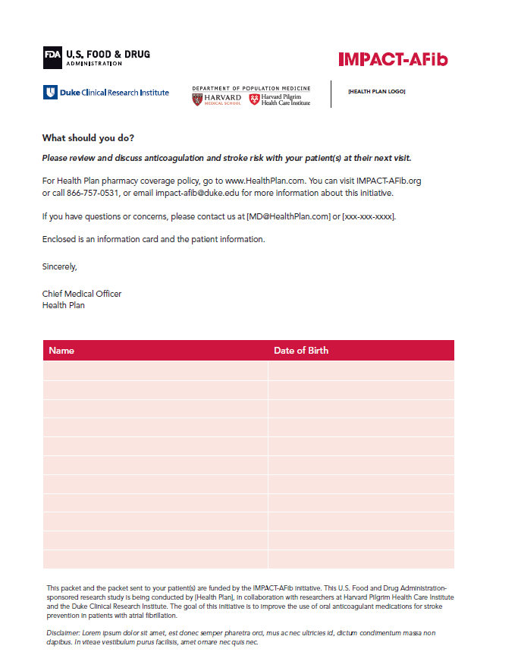
PROVIDER LETTER

Slide 22
Novel or thorny issues
Randomization of 240,000 individuals, rather than the 80,000 actually eligible population
Dynamic population, with changes in eligibility status occurring between randomization and intervention
20-40% of provider were facilities
  Health plans’ fallback varied
No control for clustering of patients within physicians or practices
Need for proxy measure of exposure to warfarin:
4 INR measurements increases # exposed ~10%
Substantial disenrollment or change in prescription drug coverage

Slide 23
Acknowledgements
Aetna: Cheryl Walraven, Annemarie Kline, Daniel Knecht
Clinical Trials Transformation Initiative: Jennifer Goldsack
Duke Clinical Research Institute: Christopher Granger, Hussein Al-Khalidi, Wensheng He, Emily O’Brien, Jennifer Rymer, Sana Al-Khatib
DPM/HPHCI: Richard Platt, Crystal Garcia, Robert Jin, Hana Lipowicz
HealthCore: Kevin Haynes, Lauren Parlett
Humana: Vinit Nair, Thomas Harkins, Yunping Zhou
Optum: Nancy Lin
Patient Representative: Debbe McCall
U.S Food & Drug Administration: Jacqueline Corrigan-Curay, Dianne Paraoan, David Martin, Melissa Robb, Patrick Archdeacon

