Slide 1
Leveraging EHR Data for Pragmatic Randomized Trials in Learning Health Care Systems in the United States – Lessons Learned from the ADAPTABLE Trial
Matthew T. Roe, MD, MHS
Professor of Medicine, Senior Investigator
Duke Clinical Research Institute

Slide 2
Conflict of Interest Statement –
Matthew T. Roe, MD, MHS
Research Funding:
  American College of Cardiology, American Heart Association, AstraZeneca, Familial Hypercholesterolemia Foundation, Ferring Pharmaceuticals, Janssen Pharmaceuticals, Myokardia, Patient Centered Outcomes Research Institute, Sanofi-Aventis
Consulting/Honoraria:
  Amgen, Ardea Biosciences, Astra Zeneca, Eli Lilly, Elsevier Publishers, Flatiron, Janssen Pharmaceuticals, Novo Nordisk, Pfizer, Regeneron, Roche-Genentech, Sanofi-Aventis, Signal Path
Publicly listed on www.dcri.org/about-us/conflict-of-interest

Slide 3

What is a Learning Health Care System?
The Institute of Medicine’s Vision:
  Research happens closer to clinical practice
  Scientists, clinicians, and administrators work together
  Studies occur in everyday practice settings
  Electronic medial records are linked and mined for research
  Recognition that health system data exist for the public good
Evidence informs practice and practice informs evidence

Slide 4
Principles for Conducting Pragmatic Clinical Trials in Learning Health Care Systems
10/2016
Leverage available medical data from electronic health records (EHRs) to identify potentially eligible patients
Recruit large samples of patients within healthcare systems to limit selection biases and provide more generalizable results that are relevant to routine practice
Simplify baseline and follow-up data collection through systematic direct patient contact and surveillance of multiple, electronic data sources
Ascertain endpoints as part of routine healthcare delivery and administrative claims retrieval

Slide 5
Framework for Evolution and Expansion of Pragmatic Trials

Slide 6
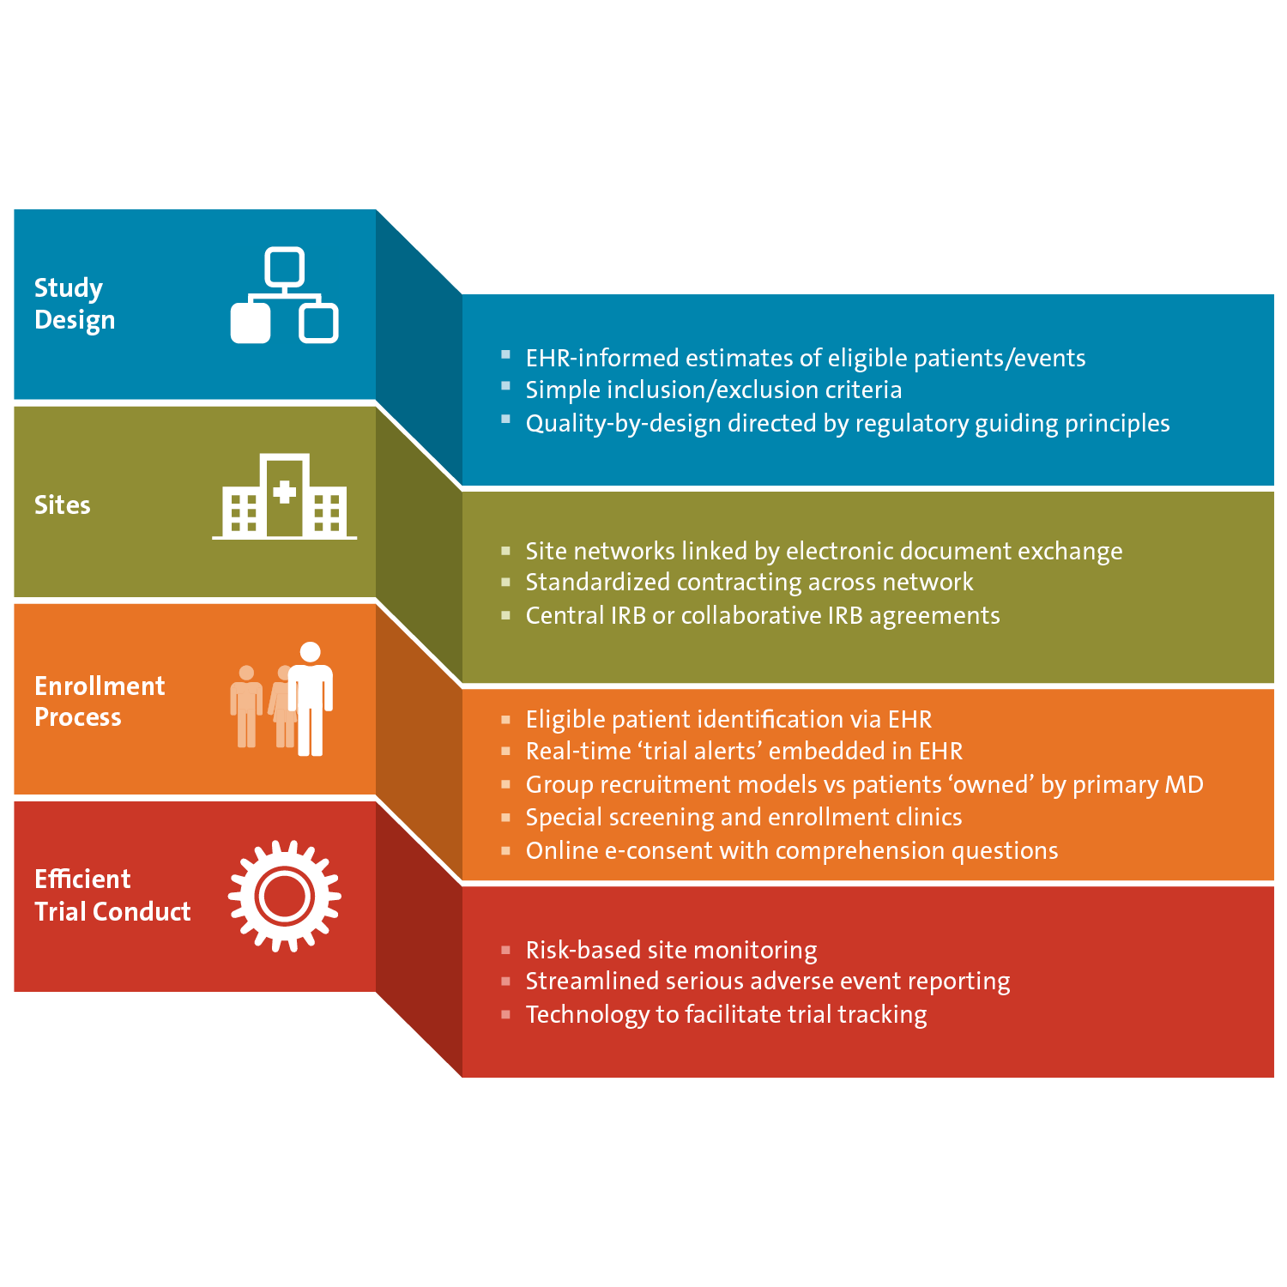
Pragmatism from Beginning to End of Trial Lifespans

Slide 7
Options for Using EHR Data to Streamline Clinical Trials
Study Conduct
Recruitment
Study Setup
Trials specific data capture at care delivery
Auto-populated CRFs fields from EHR
Extract data to facilitate work of study coordinator
Rules, Alerts & Checks
  Data completeness
  Quality compliance
  Hospitalization/AEs
  Event rates
Patient retention and education
Pre-study
Incorporate screening criteria into EHR for
  Scheduling subjects
  Contacting subjects
  Recruiting subjects
Alert provider of patient eligibility
EHR Health Portals
  Patient opt in/out for types of studies
Utilize EHR to identify local subjects/population
Feasibility dashboard
Embed encounter instructions and site content into EHR
Pre-consent & study specific consent
Model outcomes
Assess sites’ use of EHR to facilitate research
Usability of inclusion and exclusion criteria
Define & refine cohort
Cohort’s interaction profiles with health system
Feasibility analysis
Recruitment plan

Slide 8
When to Engage Patients with Pragmatic Trials:
Early, often, always from bench to bedside and back
Provide information on unmet need and therapeutic burden
Interest of research question to participant community
Provide input on study design such as barriers to participation, study endpoints, and risk/benefit perception
Advise study recruitment strategies
Support recruitment of study participants
Provide feedback on how the participant community will view results
Advise on post-market study design
Better understand adherence, persistence, access, impact
Develop the study concept
Secure funding
Prepare the study protocol
Create study procedure
Implement the study
Monitor the study
Analyze data and interpret results
Disseminate study information
FDA review and approval
Post-
approval
studies
Participants work with sponsor or researcher to support funding applications and models
Help finalize eligibility criteria within the study protocol
Assist in creating the informed consent process and form
Serve on a Data Safety Monitoring Board
Provide recommendations for revising study protocol if changes need to be made
Thank participants
Update on progress
Share findings in laypeople language
Work with trial team to develop plns for returning of individual and aggregate results;
Contrubute to lay summary devellopment
Write newsletter articles or blog posts
about results
Co-present results with sponsors and researcher at scientific conferences or in Participant communities

Slide 9
Quality by Design for Pragmatic Trials
Simple hypothesis that can be tested and addressed in a large and readily accessible patient population with high quality trial design, conduct, and execution
  Patient-directed, patient-centric approach
The definition of a quality pragmatic trial requires
  Appropriate engagement and randomization of a diverse, representative patient population
  Confirmed receipt of and compliance/adherence with the randomized treatment or intervention
  Complete ascertainment and evaluation of all potential efficacy and safety events
  Identification of any major GCP issues

Slide 10
ADAPTABLE Background

Slide 11




PCORnet® embodies a “network of networks” that harnesses the power of partnerships
20
Patient-Powered Research Networks (PPRNs)
13
Clinical Data Research Networks (CDRNs)
PCORnet
A national infrastructure for people-centered clinical research
+
=
Notes:
PCORnet is made up of two kinds of individual partner networks—Clinical Data Research Networks (CDRNs) and Patient-Powered Research Networks (PPRNs):
Our 20 PPRNs are operated and governed by patient groups and their partners
PPRNs are motivated to build an ideal network and play an active role in people-centered clinical research.
CDRNs are networks that originate in healthcare systems, such as hospitals, health plans, or practice-based networks.
They securely collect health information during the routine course of care.
Right now, there are 13 CDRNs, which serve millions of Americans across more than 100 health systems.

Slide 12
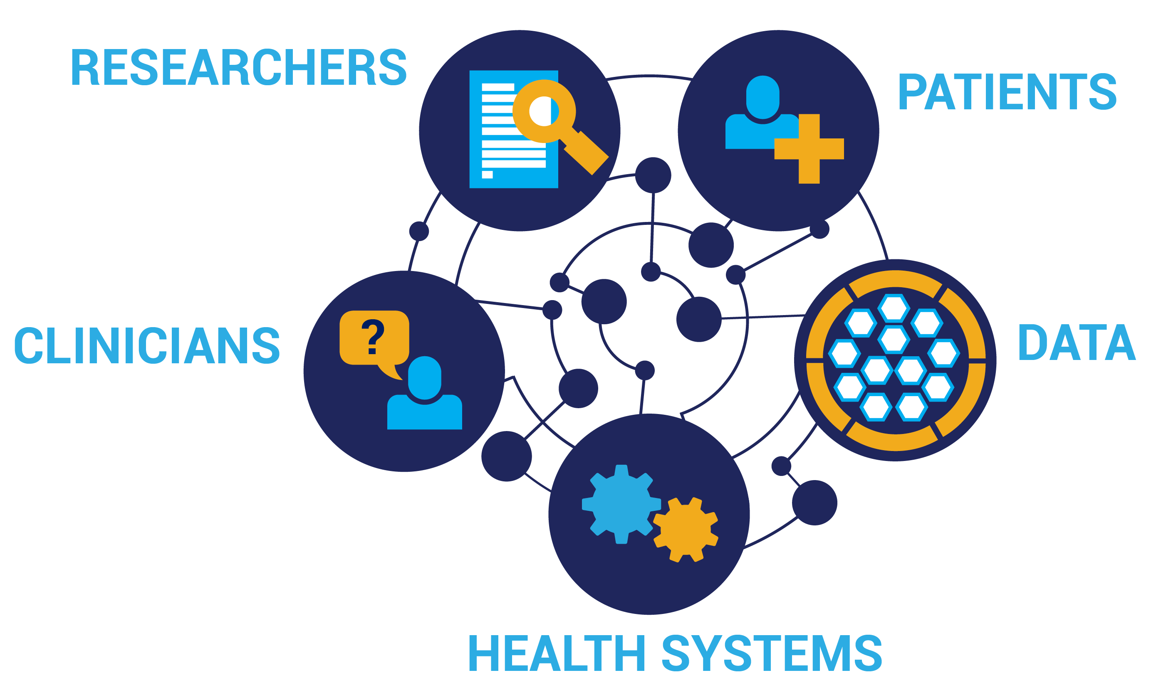
PCORNet Research Network –
Uniting Data from Patients, Clinicians, Health Systems
Notes:
This data is a result of partnerships and collaborations between researchers, patients, clinicians, health systems, and data sources. The information that is available in the Network on the approx. 110M patients comes from a variety of data sources.

Slide 13
ADAPTABLE Study Design
15,000 patients with known ASCVD + ≥ 1 Enrichment Factor
Patients identified by research networks in PCORnet through EHR/CDM searches using a computable phenotype that classifies inclusion/exclusion criteria
Patients provided with trial information and link to e-consent on a web portal;†
Randomized treatment assignment provided directly to patient
ASA 81 mg QD
ASA 325 mg QD
Electronic patient follow-up for PRO’s: Every 3 or 6 months
Supplemented with searches of EHR and claims data
Duration: Enrollment over ~ 3 years; maximum follow-up of ~ 4 years
† Participants without internet access will be consented and followed via a parallel system.
Primary Efficacy Endpoint:
Composite of all-cause mortality, hospitalization for MI, or hospitalization for stroke
Primary Safety Endpoint:
Hospitalization for major bleeding
ClinicalTrials.gov: NCT02697916

Slide 14
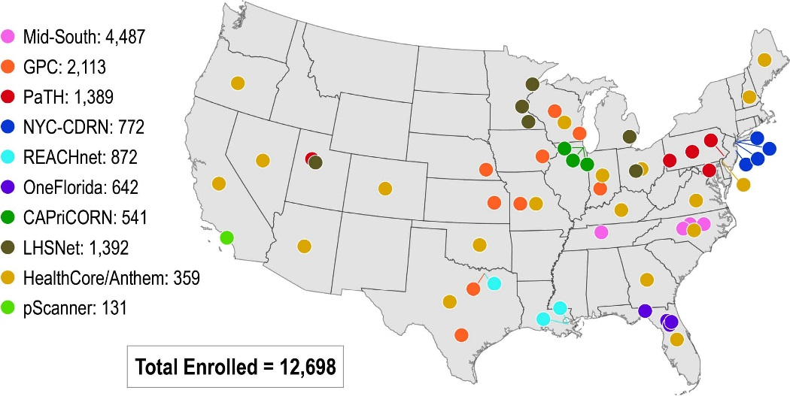
ADAPTABLE Clinical Data Research Network (CDRN) Distribution and Enrollment
ClinicalTrials.gov: NCT02697916

Slide 15
ADAPTABLE Lessons Learned –
Identification and Recruitment of Trial Participants Using EHR Data

Slide 16
ADAPTABLE Inclusion Criteria –
Computable Phenotype
Known ASCVD
Prior MI
OR
Prior revascularization
(PCI or CABG)
OR
Prior angiogram showing significant CAD
OR
History of chronic ischemic heart disease, CAD, or ASCVD
≥ 1 enrichment factor:
Age ≥ 65 years
Creatinine ≥ 1.5 mg/dL
Diabetes mellitus
Known 3-vessel CAD
Cerebrovascular disease
Peripheral arterial disease
Current smoker
Known LVEF < 50%
Chronic systolic or diastolic heart failure
SBP ≥ 140 (within past 12 mos)
LDL ≥ 130 (within past 12 mos)
Electronic Patient Outreach
ClinicalTrials.gov: NCT02697916

Slide 17
Electronic-Facilitated Recruitment Approaches
Utilized in ADAPTABLE
Electronic, computable phenotype used to query local EHR databases to facilitate widespread screening of large numbers of potentially eligible patients
Patient Outreach and Recruitment Approaches
  Direct Mail and Email (messages locally customized with input from patient representatives)
  Via health system patient portals such as “MyChart”
  “In-Clinic” Recruitment (EHR Alerts to clinic providers, Tablet-based recruitment during clinic encounters, promotion of trial during clinic)
Potential patients given Golden Ticket numbers and directed to the Adaptable web portal for confirmatory screening and electronic, web-based informed consent
ClinicalTrials.gov: NCT02697916

Slide 18
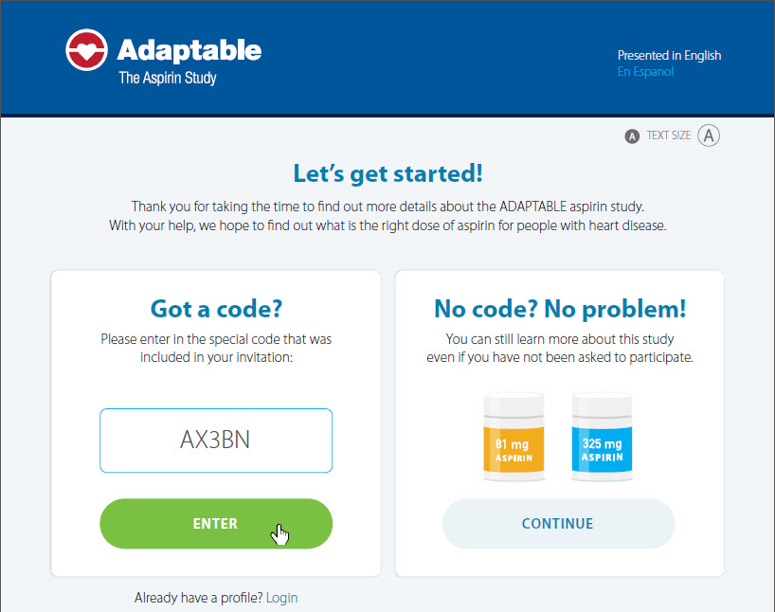
www.adaptablepatient.com
ClinicalTrials.gov: NCT02697916

Slide 19
Site Approach and Enrollment Update
CDRN | Site | Total Number Eligible | Total Number Approached | % of Eligible Approached | Golden Tickets Entered | % Golden Tickets entered per Approached | Total Enrolled | # Non-internet Enrolled | % Enrolled Per Approached | % Enrolled Per Golden Ticket Entered | Enrolled Last Week
Mid-South | Vanderbilt | 28,153 | 23,565 | 84% | 3,575 | 15% | 2,159 | 396 | 9% | 60% | 14
Mid-South | Duke | 20,127 | 11,136 | 55% | 2,685 | 24% | 1,644 | 310 | 15% | 61% | 6
REACHnet | Ochsner | 16,968 | 14,960 | 88% | 1,349 | 9% | 727 | 303 | 5% | 54% | 8
OneFlorida | U of Florida | 17,287 | 7,047 | 41% | 823 | 12% | 650 | 214 | 9% | 79% | 3
GPC | KUMC | 21,944 | 13,768 | 63% | 1,087 | 8% | 590 | 26 | 4% | 54% | 7
Mid-South | UNC | 26,426 | 12,869 | 49% | 1,785 | 14% | 584 | 82 | 5% | 33% | 0
PaTH | UPMC | 20,806 | 17,576 | 84% | 1,691 | 10% | 546 | 23 | 3% | 32% | 0
GPC | Iowa | 19,665 | 16,703 | 85% | 978 | 6% | 524 | 126 | 3% | 54% | 7
NYC-CDRN | Montefiore | 4,383 | 2,739 | 62% | 638 | 23% | 491 | 304 | 18% | 77% | 2
GPC | MCW | 14,697 | 11,761 | 80% | 1,195 | 10% | 448 | 5 | 4% | 37% | 6
PaTH | Utah | 8,961 | 10,536 | 118% | 1,041 | 10% | 442 | 44 | 4% | 42% | 3
LHSNet | Mayo Clinic | 19,468 | 12,103 | 62% | 819 | 7% | 429 | 84 | 4% | 52% | 15
LHSNet | Essentia | 18,604 | 18,604 | 100% | 743 | 4% | 417 | 72 | 2% | 56% | 2
LHSNet | UMich | 16,856 | 10,591 | 63% | 622 | 6% | 376 | 6 | 4% | 60% | 8
HPRN | HealthCore | 160,914 | 160,914 | 100% | 1,552 | 1% | 356 | 11 | 0% | 23% | 0
Mid-South | Wake Forest | 20,003 | 20,003 | 100% | 1,012 | 5% | 311 | 2 | 2% | 31% | 4
PaTH | Penn St | 6,423 | 6,657 | 104% | 754 | 11% | 260 | 11 | 4% | 34% | 0
GPC | Marshfield Clinic | 14,949 | 11,701 | 78% | 578 | 5% | 252 | 16 | 2% | 44% | 0
NYC-CDRN | Weill Cornell | 5,856 | 1,935 | 33% | 603 | 31% | 251 | 37 | 13% | 42% | 1
LHSnet | Intermountain | 41,292 | 3,178 | 8% | 530 | 17% | 249 | 23 | 8% | 47% | 10
TOTAL |  | 654,584 | 458,144 | 70% | 28,137 | 6% | 13,526 | 2,436 | 3% | 48% | 118

Slide 20
Monthly Enrollment Metrics
2016
Site | Apr 2016 | May 2016 | Jun 2016 | Jul 2016 | Aug 2016 | Sep 2016 | Oct 2016 | Nov 2016 | Dec 2016
Total Enrolled | 8 | 32 | 22 | 50 | 76 | 90 | 170 | 162 | 151
# of Sites Approaching | 2 | 2 | 2 | 2 | 4 | 6 | 10 | 14 | 16
Total Approached | 126 | 381 | 1138 | 1,196 | 1,163 | 2,342 | 7,511 | 2,539 | 7,299
2017
Site | Jan 2017 | Feb 2017 | Mar 2017 | Apr 2017 | May 2017 | Jun 2017 | Jul 2017 | Aug 2017 | Sep 2017 | Oct 2017 | Nov 2017 | Dec 2017
Total Enrolled | 294 | 361 | 448 | 599 | 609 | 512 | 503 | 456 | 395 | 414 | 425 | 391
# of Sites Approaching | 17 | 22 | 23 | 26 | 26 | 27 | 27 | 28 | 28 | 28 | 29 | 30
Total Approached | 5,176 | 11,843 | 12,890 | 16,022 | 16,433 | 14,773 | 11,702 | 5,279 | 5,345 | 2,912 | 139,900 | 6,256
2018
Site | Jan 2018 | Feb 2018 | Mar 2018 | Apr 2018 | May 2018 | Jun 2018 | Jul 2018 | Aug 2018 | Sep 2018 | Oct 2018 | Nov 2018 | Dec 2018
Total Enrolled | 474 | 479 | 553 | 490 | 536 | 594 | 548 | 518 | 496 | 565 | 464 | 297
# of Sites Approaching | 30 | 32 | 32 | 32 | 33 | 34 | 35 | 36 | 39 | 39 | 39 | 39
Total Approached | 10,636 | 11,644 | 13,493 | 5,176 | 34,348 | 8,111 | 7,982 | 13,555 | 23,460 | 16,737 | 16.017 | 3,805
2019
Site | Jan 2019 | Feb 2019 | Mar 2019
Total Enrolled | 515 | 447 | 385
# of Sites Approaching | 35 | 34 | 34
Total Approached | 13,231 | 11,542 | 6,738

Slide 21
ADAPTABLE Recruitment Methods

Slide 22
Leveraging EHR Data for Virtual Trial Recruitment
Deployment of computable phenotype in EHR databases requires local customization in each health system
  Physician groups, frequency of prior visits, etc
Multi-modal, multi-touch remote recruitment approaches most successful for large-scale enrollment unless personnel resources can support high-throughput screening during scheduled clinic encounters
  Less than 5% of approached patients will enroll
  Local clinician engagement essential for success!
Only half of patients who initially enter the ADAPTABLE patient web portal proceed to randomization
  Factors contributing to successful enrollment uncertain
ClinicalTrials.gov: NCT02697916

Slide 23
ADAPTABLE Lessons Learned –
Importance of Patient Engagement with an EHR-Facilitated Trial

Slide 24

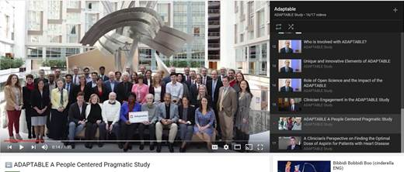
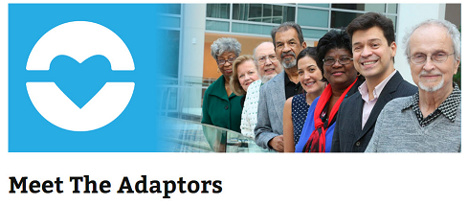
Patient Engagement Case Study: ADAPTABLE
Adaptors: Patient Partners
  Patient representatives involved from the beginning
  Helped design protocol, consent form, study portal, study recruitment materials for each site
  Contribute to study newsletter for participants
  Participate in investigator meetings & trial committees
  Active in Facebook Live programs & discussions
Notes:
We worked to communicate patient stories and pull that voice through into all the work we do to support communications.

Slide 25
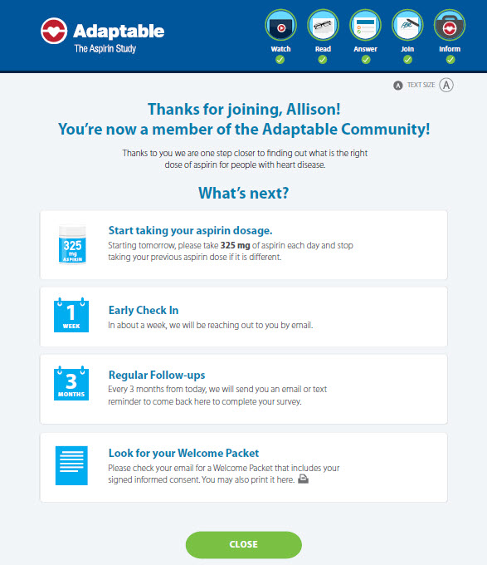

Web-Based Randomization
10/2016
Randomized treatment assignment (aspirin dose) provided directly to patients after informed consent
Reminders for electronic follow-up contacts given at time of randomization
Patients randomized to follow-up contacts every 3 months vs. 6 months
  Embedded feature

Slide 26
Attributes of Patient Engagement
Recruitment materials (especially messaging for virtual recruitment approaches) developed with direct input from patient representatives to be “patient friendly”
Look and content of study web portal directly influenced by patient representative input
Quarterly newsletters for trial participants deployed based upon recommendations from patient representatives
Collaborative, inclusive spirit of Steering Committee and DSMB interactions facilitated by involvement of patient representatives
ClinicalTrials.gov: NCT02697916

Slide 27
ADAPTABLE Lessons Learned –
Myths and Realities of Longitudinal Trial Follow Up with EHR Data Surveillance

Slide 28
Myths of Longitudinal Endpoint Ascertainment and Classification with EHR-Facilitated Trials
Endpoints (deaths and hospitalizations) are routinely captured during clinical care delivery and can be easily obtained from EHR data surveillance
Patient-reported outcomes (used to identify non-fatal events in traditional trials) are superfluous
Trial closeout processes and timelines will be more streamlined and efficient utilizing readily available EHR data
ClinicalTrials.gov: NCT02697916

Slide 29
Longitudinal Endpoint Ascertainment
Quarterly queries of the PCORnet common data model (CDM) to capture and classify endpoints
  Hospitalizations identified via standardized, validated coding algorithms developed centrally and applied to the CDM
ADAPTABLE web portal will be used to collect possible events (hospitalizations for MI, stroke, or major bleeding) during patient electronic or telephone contacts (every 3–6 months)
  Patient-reported outcomes (PRO’s) are cross-checked and verified with the CDM-generated hospitalization data
  Surveillance of CMS and private health plan data for potential “out-of-network” hospitalizations
  Medical records obtained for PRO’s not classified through other means
Death ascertainment via CDM, Social Security Administration (Medicare beneficiaries), and Call Center contacts for patients with missed visits
Notes:
LHC: Red text is not what we describe in the protocol (copied in below). We need to be consistent.
Endpoints will be ascertained by applying algorithms designed to ensure comprehensive surveillance for all potential endpoints.
•Routine queries will be applied to the PCORnet CDM to capture and classify endpoints using validated coding algorithms. Because the EHR and (by extension) the PCORnet CDM is the source of truth for the trial, no patient confirmation or other additional confirmation will be required.
•Hospitalizations for stroke, MI, or bleeding reported by patients will be evaluated in the following manner:
oQueries of the PCORnet CDM will be used to cross-check, confirm, and classify in-network hospitalizations (nonfatal MI, nonfatal stroke, or major bleeding) reported by patients.
oOut-of-network hospitalizations reported by patients and not captured in the CDM will be identified by patient self-report through the periodic electronic contacts planned throughout the study.

Slide 30
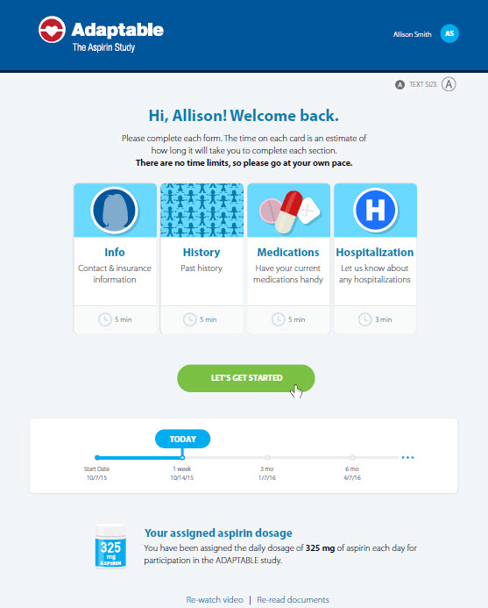
Direct-to-Patient Follow-Up
10/2016
Patients receive email reminders to visit web portal for regular contacts every 3 vs. 6 months
Central DCRI Call Center performs telephone contacts when needed
  Non-internet participants (20%)
  Participants who miss at least 2 scheduled electronic contacts

Slide 31
ADAPTABLE Endpoint Reconciliation Process
Patient Reported Events
Gold Standard
EHR Data
(PCORnet)
Private Health Plan Data
Medicare Claims Data
Endpoint
Confirmed
Yes
Does event match a previously identified trial endpoint?
Wait for next PCORnet refresh
Captured in Gold Standard Source
No
Endpoint
Not Confirmed
Yes
Does event coincide with a hospitalization in gold-standard data source that did not result in a trial endpoint?
Apply algorithms for trial endpoint identification
Out-of-network
No
In-network
Is event date post censor date?
Yes
No
Query site coordinator to check EHR
Send to Call Center to obtain patient records
No
Is event in EHR?
ICF allowed
Yes
Obtains Patient Authorization
Yes
Apply algorithms for trial endpoint identification
Obtained hospital abstract summary (coded)?
No
Endpoint
Unable to Obtain
No
Obtained other medical records?
Did applied algorithms identify a trial endpoint?
Endpoint
Not Confirmed
No
Yes
Endpoint
Not Confirmed
No
Did review lead to an identified trial endpoint?
Yes
Yes
ADAPTABLE Trial Endpoints

Slide 32
Extended Timelines for Trial Closeout Using EHR Data
Recruitment Began
Recruitment Ends
EOS Visit >April 2019
~9K
April 2016
Mar 2019
May 2019
Oct 1, 2019
Nov 1, 2019
Nov-Dec 2019
WE ARE HERE
EOS all
non-int. & rescues
~5K pts
EOS Visit
April ‘19-
Last Pt
~1K pts
Common
Study End
Date
Final CDM Query
Database
Lock
Dec 31, 2019
Jan 2020
Feb 2020
March 2020
April 2020
June 2020
Vital Status Sweep
PRO Recon Records
Final
Report

Slide 33
Realities of EHR-Facilitated Longitudinal Endpoint Ascertainment and Classification
Approximately 30% of patient-reported hospitalizations occur ”out of network” and not captured in local EHR databases
  Up front consent from participants for medical record release needed to facilitate retrieval of source data
Periodic direct patient contact essential to ensure complete ascertainment of all potential trial-related endpoints
  Central telephone call center needed to complete contacts for non-internet participants, those who missed scheduled electronic contacts, and to retrieve ”out of network” records
Majority of deaths occur out of hospital and are thus not captured in EHR data surveillance
  NDI data latency of 18 months not feasible for death ascertainment for a prospective trial
ClinicalTrials.gov: NCT02697916

Slide 34
ADAPTABLE Lessons Learned –
Supporting Sites/Health Systems to Succeed

Slide 35
Lessons Learned for Site Selection for EHR-Facilitated Trials
Experience: Sites/health systems with previous experience recruiting patients with the disease of interest with low rates of LTFU, early discontinuation, and withdrawal of consent
Efficient Operations: willing to use a central IRB and allow central follow up via central web-based or telephone-based contact to augment local follow up leveraging EHR queries
Track Record: evidence of sufficient expertise in curating and interrogating local EHR data warehouses to support patient identification and trial conduct
  Sites/health systems need a viable recruitment plan that covers use of their EHR data to facilitate high-throughput screening, rapid patient outreach/contact, pre-consenting, and stakeholder engagement

Slide 36
Importance of Clinician Engagement for ADAPTABLE
Local data science/informatics champions key initiators and drivers for developing PCORNet data infrastructure
  High quality EHR data systems not enough to recruit patients into a prospective intervention trial
Clinicians involved need prior clinical trial investigator experience to facilitate all aspects of site trial start up and execution to ensure recruitment success
  Recognition and incentives for clinician involvement in site-based research are key components for success
Large-scale recruitment only possible if multiple physician groups (or entire divisions) work together to provide access to and support for approach large patient samples
  Clinical champions key ingredient for success!
ClinicalTrials.gov: NCT02697916

Slide 37

Site Clinical Trial Teams – Building for the Future
Traditional Trial Teams
  Clinician investigators from a single practice
  Research coordinators
Transformational Trial Teams
  Patients with disease of interest
  Clinician investigators across practices within health systems
  Research coordinators
  Health systems informatics experts
  Health systems data scientists
  Health systems IT analysts

Slide 38
ADAPTABLE Lessons Learned –
Conclusions

Slide 39
Pragmatic Trials in Learning Health Systems
Pragmatic, simple trials can be successfully executed within learning health systems across the United States
  Strong collaborations needed among clinicians, research personnel, patient partners, and informatics experts
Use of EHR data to facilitate trial execution will drive future transformation but nimble, flexible approaches needed to ensure trial quality standards are achieved
  Iterative systems needed to maximize efficiency and data capture
All clinical trial stakeholders embrace pragmatic trials
  Learning curve is steep and open sharing of lessons learned is essential to optimize collaborations and development of research networks capable of conducting trials of the future

